Slide 1
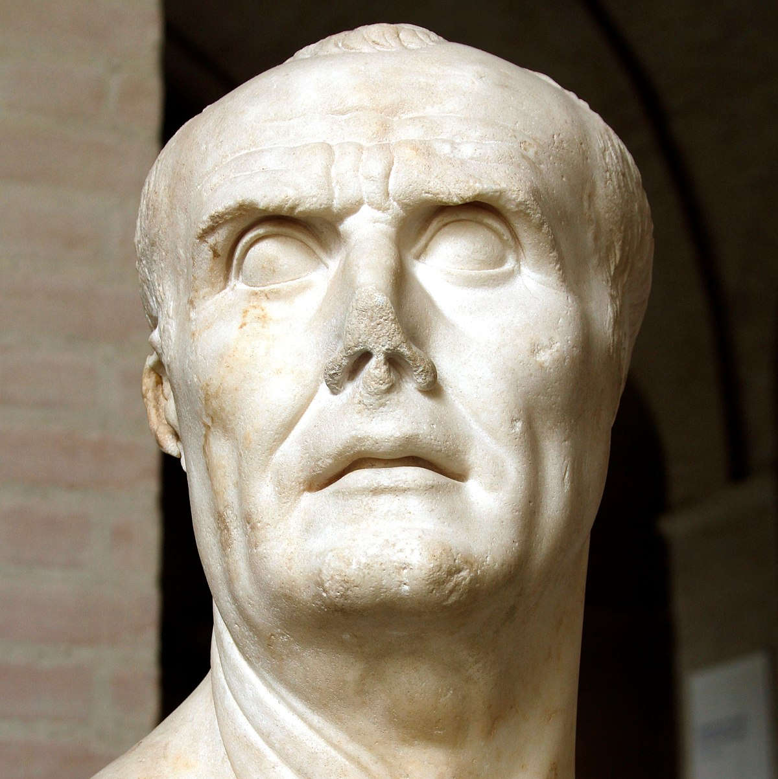
Marius’ Reforms
GOAL/S: Examine Marius' reforms to the Roman army and their implications.
Week 7, Lesson 1

Slide 2
REVIEW – Gaius Marius
Get ONE (1) mini whiteboard, texta, and cloth between two.
Put your book under your desk and close it
In pairs, answer the following questions on your whiteboard
Keep tally of your score on the corner of your whiteboard
HOVER IT - CHIN IT – PARK IT

Slide 3
1. When and Where was Gaius Marius born?
HOVER IT
Notes:
ANSWER: 157 BCE Arpinum, Latium

Slide 4
2. What social class were his family a part of?
HOVER IT
Notes:
ANSWER: Equestrian

Slide 5
3. Novus Homo means…
HOVER IT
Notes:
ANSWER: New Man

Slide 6
4. 134 BCE: served as a __________________________ at Numantia in Spain under the famous general Scipio Aemilianus.
HOVER IT
Notes:
ANSWER: military officer

Slide 7
5. ________BCE: elected to the position of Tribune of the Plebs
HOVER IT
Notes:
ANSWER: 119BCE

Slide 8
6. In what YEAR did the Roman senate declare war on Jugartha?
HOVER IT
Notes:
ANSWER: the Senate finally declared war on Jugurtha in 111 BC.

Slide 9
7. In 109 BCE, one of the Metelli family, Quintus Caecilius ____________, was elected as consul and was sent to Numidia to take control of the campaign.
HOVER IT
Notes:
ANSWER: Metellus

Slide 10
7. In 109 BCE, one of the Metelli family, Quintus Caecilius ____________, was elected as consul and was sent to Numidia to take control of the campaign.
HOVER IT
Notes:
ANSWER: Metellus

Slide 11
8. In what year was Marius successfully elected CONSUL?
HOVER IT
Notes:
ANSWER: 107BCE

Slide 12
PACK UP WHITEBOARDS
Book out!

Slide 13
Today’s Lesson:
Marius' Reforms and their implications
Analyze how these reforms changed the dynamics of Roman military power

Slide 14

By 107 BCE , Marius was popular with the people, and the Assembly voted for Marius to take command of the Jugurthine War instead of Metellus. Marius had encouraged them in this decision by boasting that his experience in North Africa had given him an insight into how the war could finally be won. Before he sailed to Numidia to take charge, Marius needed to raise an army. However, the issue of landless citizens, which Tiberius and Gaius Gracchus had tried to fix remained an ongoing problem in the recruitment process. Marius could not find enough soldiers to create the forces he needed.

Slide 15
So, Marius devised with a practical solution. Rather than requiring soldiers to own their own land, Marius asked for volunteers, regardless of their level of wealth. He offered to pay these volunteers while they were on campaign. This had never been done before. Prior to this, soldiers were responsible for their own upkeep. The brilliance of Marius' change to recruitment is that many more people came forward to serve in his army. The attraction of receiving regular pay was made more enticing by the fact that Marius also promised to give each soldier their own land when they completed their military service. This new scheme was very successful. Marius quickly raised an army and headed to north Africa to begin his campaign against Jugurtha.

Slide 16
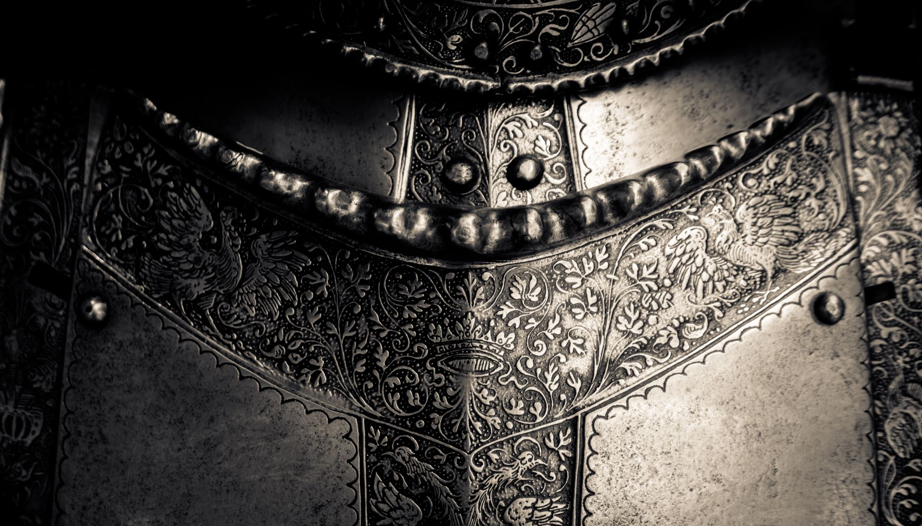
The Marian Reforms were a turning point in ancient Roman military history.
They were instituted by Gaius Marius in 107 BC and can be broken down into three major reforms:

Slide 17
ACTIVITY – Y CHART
Create a Y Chart in your books
In each section, write key words describing each of the MARIAN REFORMS

Slide 18
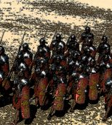
1. First Ever Standing army
previously enlisted its soldiers on a season-by-season basis
dissolved its army after every campaign
establishing Rome’s army from scratch
able to change organisation
choosing to make the century (a group of 100 soldiers) the basic unit from which his legions were built.

Slide 19
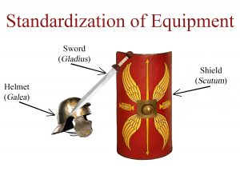
2. Enlistment and Equipment
secured the rights of the poor to enlist in the Roman army
hadn’t previously been allowed
previously been required to provide their own arms and armour
common people couldn’t purchase
Standardized the
ensured that his new army would provide each of its soldiers with said equipment

Slide 20
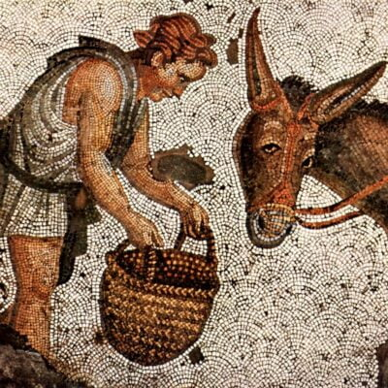
3. Land Compensation
soldiers served enough time - compensated with a plot of farmland for them to retire to
primary incentive for the common people
land ownership was the best way for them to lift their way out of poverty and improve the quality of their lives.

Slide 21
ACTIVITY – War and Conflict
Read through the text ‘War and Conflict’
Answer the following questions in your book:
Explain how Marius won the Jugurthine War
Identify the key people, events, and ideas of the ‘War Against the Cimbri and Teutones’
When was Marius elected Consul, and why was this so shocking?
Who is Sulla? Describe his feelings towards/relationship with Marius.

